Slide 1

Keep Me Updated: An Empirical Study on Embedded JavaScript
Engines in Android Apps
Accepted in MSR 2024
Notes:
Next I am going to talk about the another work. I've had the awesome chance to work alongside Professor Law and his student, Jiaxiang. They've been amazing, offering tons of helpful advice and insights. The title is Keep Me Updated: An Empirical Study on Embedded JavaScript
Engines in Android Apps

Slide 2
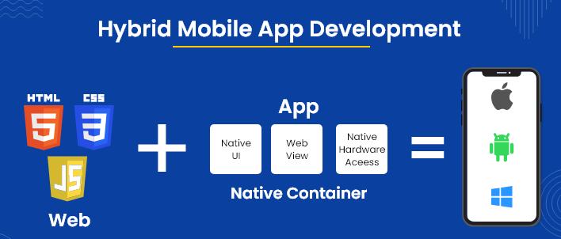
JavaScript (JS) is one the most popular programming languages.
Although it is mainly used in web applications, JS has also been gaining significant traction in the mobile applications development.
This adoption is attributed to several distinct advantages, including higher portability, lower development costs, and faster build times. We will call this application hybrid apps
Hybrid Apps provide higher portability, lower development costs, and faster build times
Notes:
JavaScript (JS) is one the most popular programming languages.
Although it is mainly used in web applications, JS has also been gaining significant traction in the mobile applications development.
This adoption is attributed to several distinct advantages, including higher portability, lower development costs, and faster build times. We will call this application hybrid apps

Slide 3
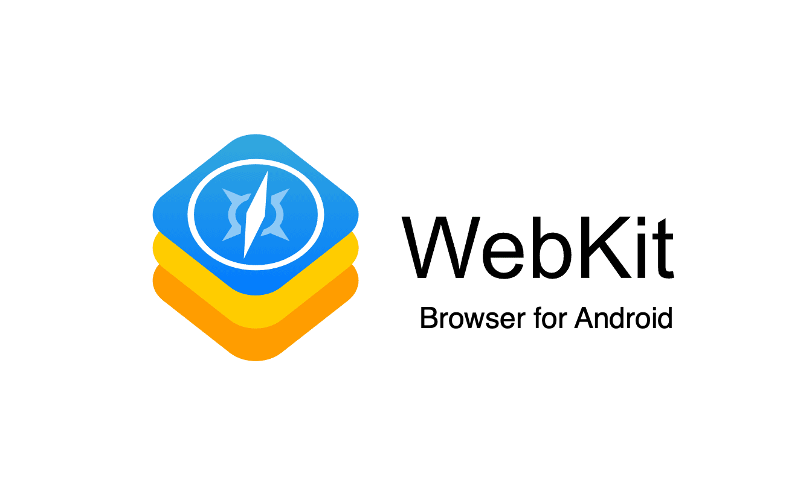

Javascript Engines
A hybrid app needs to use Javascript engines as the execution environment
Javascript may be executed in a system-wide browser engine.
Extensive research has been done to investigate their potential security implications^{[1,2,3]}.
[1] M. A. El-Zawawy, E. Losiouk, and M. Conti. Vulnerabilities in android webview objects: Still not the end! Computers & Security, 109:102395, 2021
[2] Y. Ma, Z. Hu, Y. Liu, T. Xie, and X. Liu. Aladdin: Automating release of deep-link apis on android. In Proceedings of the 2018 World Wide Web Conference, pages 1469–1478, 2018.
[3] W. Song, Q. Huang, and J. Huang. Understanding javascript vulnerabilities in large real-world android applications. IEEE Transactions on Dependable and Secure Computing, 17(5):1063–1078, 2018
Notes:
A hybrid app needs to use Javascript engines as the execution environment. To do that, they can use a system-wide browser engine as the execution environment. For example, WebView in Android and WK-
WebView in iOS. Many research has been done to investigate their their typical applications
and potential security implications

Slide 4
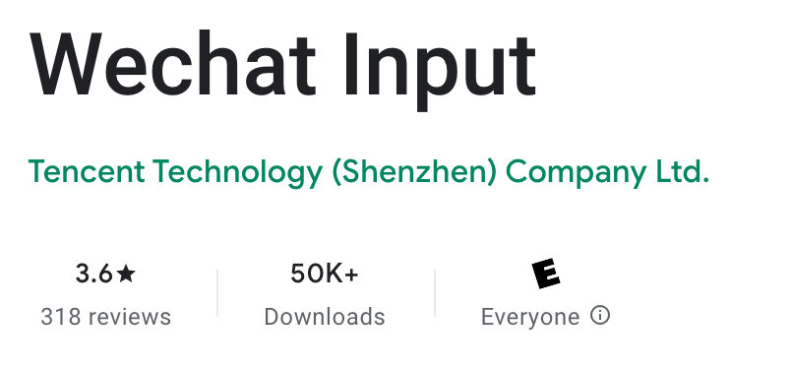
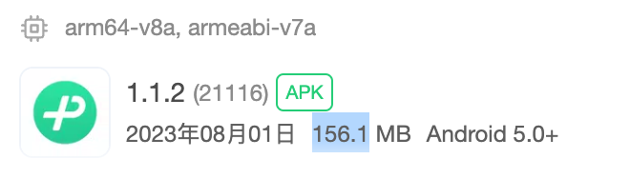
Apps may bring their own
Alternatively, an considerable number of apps seem to ship an embedded JS engine rather than as a native library.
Many of them allow arbitrary JS input.
Rarely explored in previous research.
An recent example is the WeChat input method, as a simple Chinese input method, it consume around 200 mb’s space. This is because they ship a full chrome engine inside their application.
We argue that security implications in these shipped engines can be very critical based on two key observations: They are seldomly updated and they most of the time, they are allowed to accept arbitrary js input.
This is an important aspect that is rarely explored in previous research
Notes:
However, not many people know that a hybrid app can also make use of JS engines shipped as a native library. An recent example is the WeChat input method, as a simple Chinese input method, it consume around 200 mb’s space. This is because they ship a full chrome engine inside their application.
We argue that security implications in these shipped engines can be very critical based on two key observations. They are seldomly updated and they most of the time, they are allowed to accept arbitrary js input. This is an important aspect that is rarely explored in previous research

Slide 5

Research Questions
RQ1: What is the scale of Android Apps that embed JS engines as native binaries?
RQ2: What functionalities do the embedded engines serve within the apps?
RQ3: What versions of JS engines are being utilized?
RQ4: Do the embedded engines receive security updates? If so, what is the update frequency
RQ5: To what extent are the JS engines affected by security vulnerabilities?
Notes:
To illustrate these points, we conduct an empirical study to com-
prehend the following research question. 1) the prevalence and utilization of embedded JS engines,
2) their versions and the extent to which developers update them,
and 3) vulnerabilities within the JS engines and their security impli-
cations for hybrid apps.

Slide 6
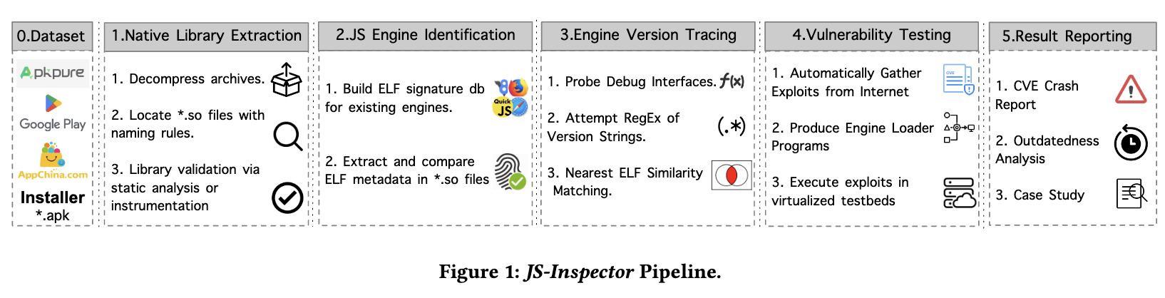
JS-Inspector
We developed an analysis pipeline named JS-Inspector.
Notes:
To facilitate our objectives, we develop an analysis pipeline named JS-Inspector,
Given an Android installation package (i.e., APK), this pipeline can extract
its native libraries and determine whether they contain a JS engine.
Once identified, the pipeline proceeds to determine the specific
engine version number. With this information, our pipeline generates a testing program
that to executes every known exploit for the engine and observes any abnormal behaviors. If observed, our pipeline generates a comprehensive crash report and for human experts to conduct further analysis. Let’s have a look at a few important component of this pipeline.

Slide 7



APK Dataset Curation
A large-scale Android app dataset.
Source: Google Play, Andzoo, APKPure, and APKChina.
Collected on July 2023, spanning a timeframe of five years.
1,022,327 APKs and 65,721 unique apps
Notes:
For our study, we've put together a huge dataset with over a million APKs, covering a span of 5 years. We gathered these apps from different application store, such as Google Play and Andzoo.

Slide 8

JS Engine Identification
Aim: Determine whether a native library contains a JS engine. If so, what version?
Static Approach: String RegEx, ELF Similarity Measurement (i.e., import/export symbols)
Dynamic Approach: Invoke Debugging Interfaces at runtime (i.e., v8::GetVersion())
Notes:
After gathering the Apps, we process to determine whether a APK contains a known JS engine. We’ll extract its native library and examine the library through two main approaches: First, static analysis, where we use String RegEx to search for engine-specific patterns, and ELF Similarity Measurement to compare import/export symbols against known engines.
In addition to that we also use dynamic analysis, where we can invoke well-known engine debugging interfaces during runtime, to pinpoint the engine and its version."

Slide 9
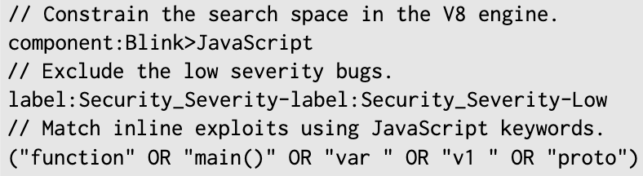
Curate Exploit Databases
We construct a database of 129 JS exploits revealed between Jan 2019 to May 2023.
Sources: Search engines in Chromium bug tracker and Webkit bug tracker.
Notes:
After probing the engine version, our pipeline proceeds to deter-
mine if it is susceptible to known vulnerabilities. We construct a database of exploits for JS engines. We primarily gather the exploits from the engine’s bug tracking system. Very often, a public bug report will contain an exploit as an attachment or inline text We can
Easily locate such a report with carefully engineered search queries.

Slide 10
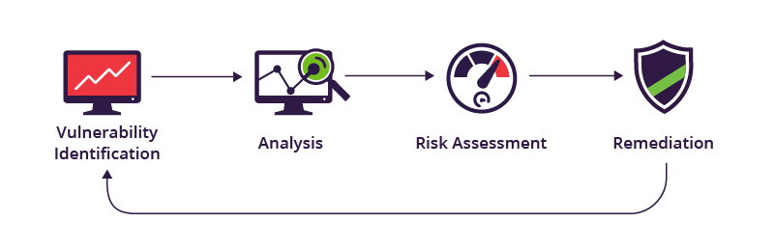
Vulnerability Testing
Given a JavaScript engine library, our testing platform conducts the following tasks:
Load the target library into memory.
Initialize the engine.
Compile & Execute Exploit Codes.
Generate bug report with stack traces.
Notes:
With the engine and vulnerability in place, we can proceed to test the engine against the exploit, Our testing platform will Load the target library into memory, Initialize the engine., Compile & Execute Exploit Codes and generate stack trace if possible.

Slide 11
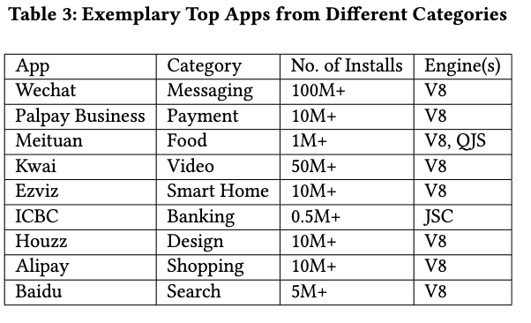
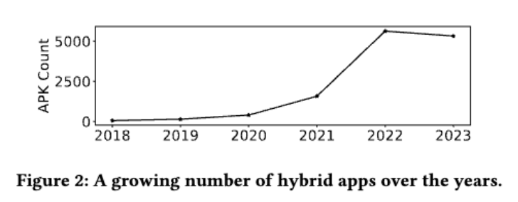
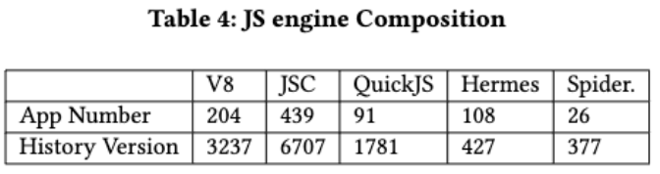
RQ1: Prevalence of JS engines in Android Apps
⚠️ Embedded JS engines are increasingly prevalent in highly-ranked apps. The two most common engine types are V8 and JSC.
Notes:
Using this pipeline, we successfully answer our research question, The first observation is that Our pipeline detects arond thousand of apps utilizing JS engines shipped as their native libraries. Most of these applications are highly ranked such as WeChat and PayPal. There is a continuing growth in the number of such hybrid apps.
Meanwhile, we also have a look at that the composition of Javascript engine, V8, the engines and Javascripcore behind the Firefox are the two most popular engines and can can be found in more than 600 apps.

Slide 12
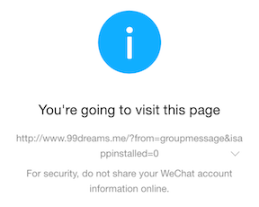

RQ2: Utilization of JS engines
Cross-platform Development (React Native)
Custom WebView: Baidu Zeus, Alibaba UCSDK, and Tencent XWeb
Notes:
We also conduct a review ofthose 1000 app to understand what kind of purpose does their JS engines serve. Not suprisingly, The most common use is in cross-platform development frameworks, such as React Native. The second application is for creating custom web page display components. A notable example includes platforms like WeChat or QQ, which allow users to view web pages directly through messages. This could technically be done using a system-wide browser, but embedding a JS engine allows for customized behavior. For instance, if a link leads to content that's restricted in certain regions, access can be blocked.
JS engines also play a significant role in super
apps, a new software paradigm that combines diverse functionalities
within a unified app [ 66 ]

Slide 13


RQ2: Utilization of JS engines
Super Apps: Wechat, KaKao, TikTok, & Kwai.
Game Engines: Cocos2d-JS, Layair
Notes:
JS engines also play a significant role in super apps, a new software paradigm that combines diverse functionalities within a unified app. For example, you can use WeChat to make an appointment with a taxi. A super-app vendor generally allows third-party developers to implement a mini app using HTML, CSS, and JavaScript. Therefore it requires a JS engine. Another common use is mobile game
engines, which allow you to implement game logic using Javascript. The most famous engine is Cocos2d-JS

Slide 14
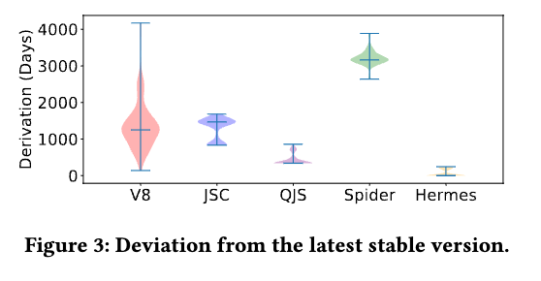
RQ3: Engine Outdateness
⚠️ Hybrid apps in our dataset include JS engines that are outdated for 1,338 days averagely.
Notes:
Next, we looked into how outdated the JS engines are in these hybrid apps. We did this by identifying the engine version used in the app's latest version and comparing it to the most recent release of the engine. By measuring the number of days between these two versions, we discovered that, on average, the hybrid apps in our dataset use JS engines that are 1,338 days out of date. In a worst case, we found an app that has been using an engine ten year old.

Slide 15
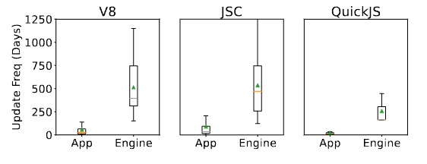
RQ4: Update Frequency
⚠️ Around 85% hybrid apps never receive engine updates despite they have relatively frequent new releases.
⚠️ Even among the apps that receive updates, the frequency remains remarkably low (on average less than once a year).
Notes:
We also investigate the frequency at which embedded JS engines receive updates.
Remarkably, a majority of hybrid apps (85\%) never update their embedded engines since the day one of the release. Even among the remaining of 15% apps that receive updates, the frequency remains remarkably low .on average less than once a year. This is significant lower then the app’s update frequency.

Slide 16
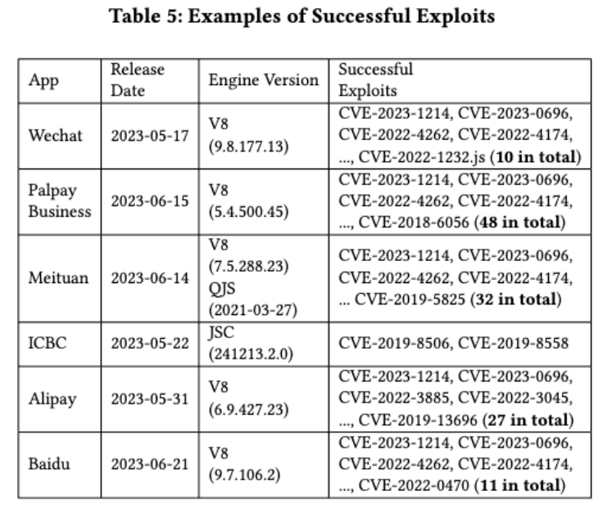
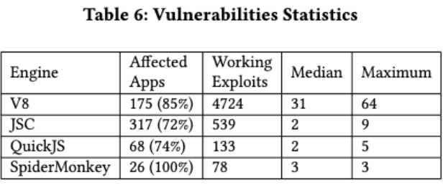
RQ5: Vulnerability Impact
⚠️ Approximately 70% hybrid apps in their latest versions are susceptible to known exploits
Notes:
We evaluate our exploit database on the embedded JS engine We found that Approximately 70% hybrid apps in their latest versions are susceptible to known exploits. Some of them are even top-ranked apps such as Alipaya, we chat pay, and PayPal. The showcase the serveity of the embedded engine security issue.
Engine-wise speaking, 85% of V8-based apps are affected by security vulnerability; 72% of JSC-based apps show vulnerablitiy
nerability, with a median count of 2 and a maximum count of 9. Similarly, 74% QuickJS-based apps demonstrate vulnerability, with a median count of 2 and a maximum count of 5

Slide 17
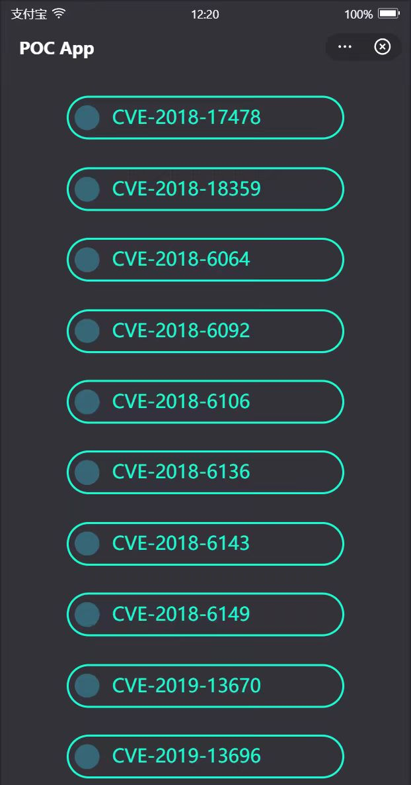
Case Study 1: Super App
We published a malicious mini-app in Alipay.
We identified 27 working exploits that can crash the super-app.
The same app can be published to more than 10 super-apps from the Alibaba Group with minor code modifications.
Notes:
In our paper, we also conduct three case studies to understand how we make use of these detected vulnerabilities.
In the first case study, we create and publish a malicious mini-ap in alipay.
When user opens the mini app, we will run all known exploit in the background. In our study, We identify 27 working exploits that can
cause the super-app to crash or become unresponsive. a mini-app created for Alipay
can be effortlessly distributed across more than 5 super-apps from
the Alibaba Group with minor code modifications. This signifiy the urgency to look into super app security issue further.

Slide 18
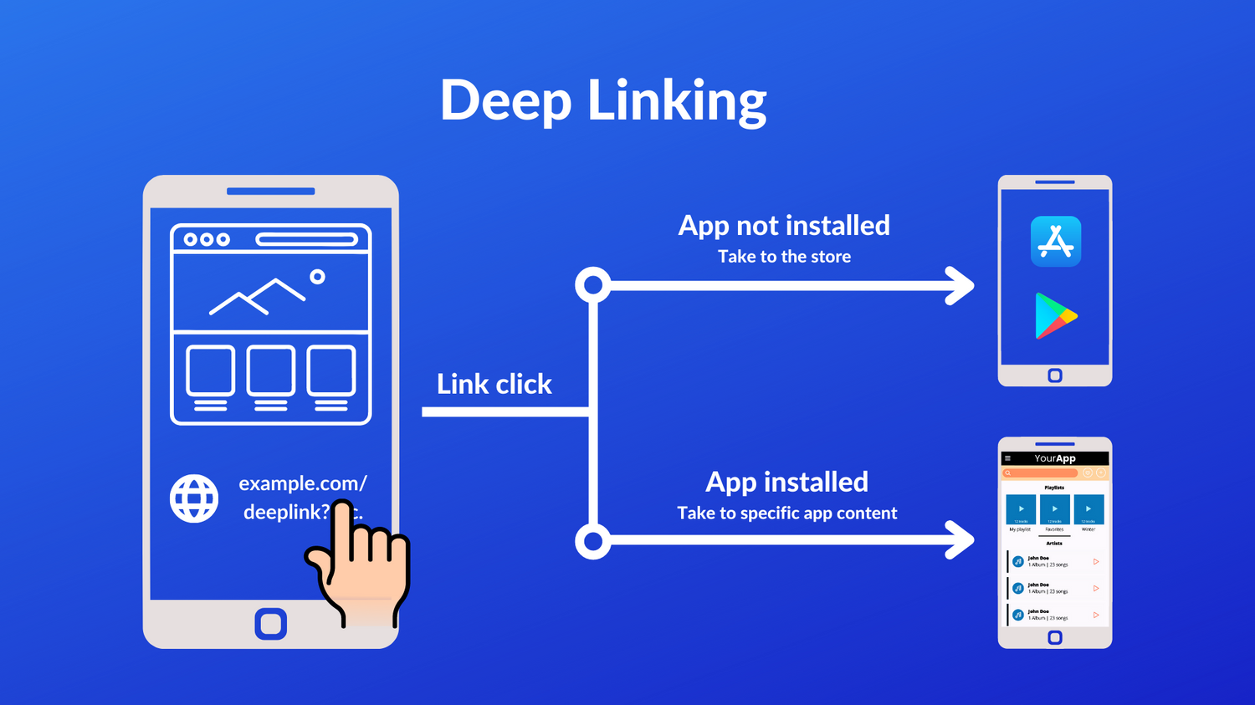
Case Study 2: Intent-based Attack
A well-crafted URI ‘alipayqr://platformapi?app=ID’, where ID represents the identifier of a malicious mini-app.
The link can be sent through instant messaging applications like Wechat.
If clicked, it automatically launches the malicious mini-app and execute exploits within its JS engine.
Notes:
In the case study 2, we call it intent-based attack. Here, we try to launch attack with the malicious mini-app from the previous study.
A malicious app could send out an intent with the URI
‘alipayqr://platformapi?app=ID’, where ID represents the identifier
of a malicious mini-app. By doing so, it can automatically launch
the mini-app and execute exploits within its JS engine. And put your phone in danger.

Slide 19
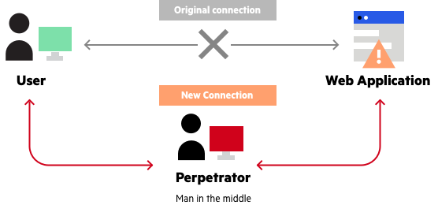
Case Study 3: Man-in-the-middle
Inject malicious JS snippets when the embedded engines request HTML pages or JS files.
We successfully triggered 11 exploits in Baidu searching App.
Notes:
In the previous two study, we still require a certain amount of user interaction. In case study 3, we want to make the attack completely transparent. We achieve this by launching the man-in-the-middle wifi access point attack, where we set up a rouge ap to intercept and alternate the communication between the user’s app and the intended website. We then can insert malicious JS exploit and the user will execute without notice. This can potential open a door for arbitaru code execution.

Slide 20

Potential Prevention
Executing Trusted JS Scripts Only.
Disable Just-in-time compilation.
Sandboxing.
More?
Notes:
How about prevention strategy? Unfortunately, not many.
In our case studies, we demonstrate three strategies for exploiting those vulnerable JS engine. A crucial step of these approaches involves deceiving the engine into loading and executing arbitrary scripts from external sources. Consequently, we can prevent such attacks by restricting the engine to load scripts solely from trusted server. But this is easier said than done, for example, like super-app, you anyway has to allow the user to execute code from different developers.
2. Many exploits used in this research derive from flaws in an engine's Just-In-Time (JIT) compiler.
This is because a JIT compiler needs to make specific memory layouts and type assumptions due to the dynamic nature of the JS language. If attackers could craft some code to breach these assumptions, they could trigger dangerous behaviorA potential mitigation is to turn off JIT compilation for apps. However, this can potentially make the app slow.
3. Many conventional browser sandboxing tech-
niques are not applicable in Android due to the absence of multi-
processing capabilities, in particularly, fork and exec. We also need into these further in the future research

